Slide 1
Performance Measures of Database Types and Transformation Solutions in ETL Pipelines
Jeff Nguyen and Reannan McDaniel

Slide 2
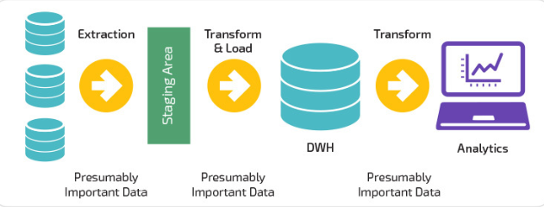
Purpose
Extract Transform Load (ETL), is a popular process in data warehousing
We aim to identify database and transformation solutions that are most efficient
Which performs best; MySQL (SQL) or MongoDB (NoSQL) using Pandas or cuDF?
Notes:
Combinations used for this project:
MySQL – Pandas/cuDF – MySQL
NoSQL – Pandas/cuDF – NoSQL
We want to compare differences between MySQL vs. NoSQL; and Pandas vs. cuDF

Slide 3
Hypothesis
We expect MySQL to take longer in read/write operations compared to NoSQL
Transformations may take longer in NoSQL as there is a potential for duplicate data
cuDF will outperform Pandas in data transformation
Notes:
Since the data is normalized, in MySQL we expect the transformation process to work faster than in NoSQL.
Modification of data in MySQL will occur in one location (a tabular relational database) for normalized data
Modification of data in NoSQL requires referencing multiple documents
However, the read write process would take more time in MySQL than NoSQL due to:
ACID compliant properties required in relational databases.
Note about cuDF
note

Slide 4
What is ETL
Extraction, transformation, and loading is a process used to generate data that is in a usable form for, but not limited to, modeling and reporting purposes.
Extraction
Extraction involves moving data from a database into a data transformation environment
Transformation
Transformation is the process used to prepare data for loading into a database
Loading
Loading takes transformed data and moves it into a data warehouse or data lake
Notes:
This process can be demanding and may require larger amounts of resources as the volume of data increases.
More storage space
Man hours for ETL maintenance
-Transformation:
Systems require data to be in a certain form, the transformation step of ETL prepares that data for the target system
-Loading:
Loaded data may or may not be normalized based on business requirements
Data is usually extracted from a database into pandas, R, or other data manipulation environment
Several examples of 3rd party ETL processes are:
Informatic PowerCenter
Azure
Apache Camel/Kafka

Slide 5
What is SQL and NoSQL
What is MySQL
Why do I need it?
How is it different from Oracle?
What is MongoDB
Why do I need it?
Notes:
MySQL is a free open-source relational database management system initially released in 1995.

Slide 6
Problems encountered?
Notes:
Transformation is the process used to, but not limited to: manipulate; modify; clean; merge; select and engineer features

Slide 7
Notes:
After covering this slide read the following:
“For implementation the following database types and manipulation library are being used for this project”

Slide 8
Implementing Extraction/Loading: MySQL
MySQL is an open source RDBMS
Ideal for relational data
Requires normalization of data for efficient operation
Utilizes Structured Query Language
Notes:
One possible database for the extraction/loading phases is MySQL

Slide 9
Implementing Extraction/Loading : NoSQL
Is a database solution that typically models non-relational data
MongoDB and Apache Cassandra are examples
Does not require data to be normalized
Notes:
An alternative database for the extraction/loading phases is MySQL

Slide 10

Transformation: What is Pandas?
Open source Python data manipulation library
Contains many inbuilt functions
Notes:
Pandas’ inbuilt functions that allow for data to quickly be cleaned, modified, and analyzed
- Used in a python environment
- Common data manipulation tool like dplyr

Slide 11

Transformation: What is NVIDIA RAPIDS?
Allows users to take advantage of a GPU’s thread count and high bandwidth dedicated memory
cuDF is a data manipulation library
Notes:
NVIDIA RAPIDS is an open-source suite of data manipulation and machine learning libraries
Optimized for use with GPUs
Syntax is nearly identical to Pandas

Slide 12
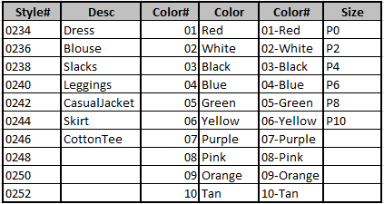
Data
Procure data from Kelly-Moore Paints Company
Transform 406 paint SKUs from paint to 406 SKUs for a women's boutique clothing line
The schema used is a combination of article type, color and size

Slide 13
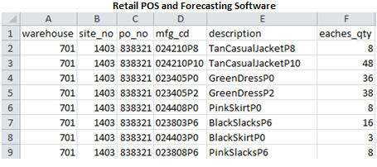
Data
The data is generated from 2 sources
Retail Point of Sale
Forecasting software
The data is comprised of:
Order recommendations – at the site level
Actual sales – at the site level
Notes:
Retail POS is Retain.net (old grocery store POS now owned by Kelly-Moore)
Forecasting software is Logility

Slide 14
Data
Kelly-Moore Paints data pulled from data warehouse
Data needed to be reverse engineered into it’s normal form
This is done to test extraction and transformation phases of ETL

Slide 15
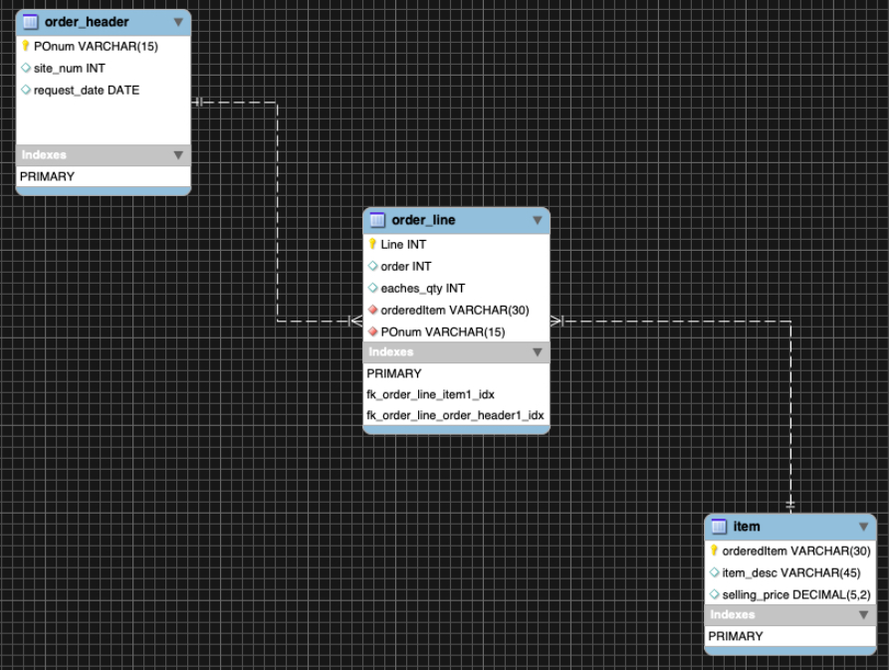
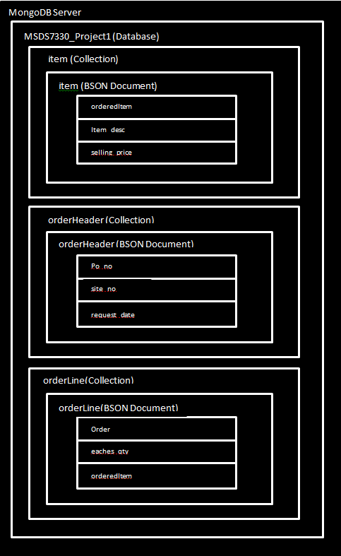
Data
MYSQL
MongoDB
Notes:
Data is in the process of normalizaiton

Slide 16
Measuring ETL Performance
Performance metrics such as: CPU usage, RAM usage, and time to execute operations will be captured
Metrics will be captured at the following points in the ETL process:
Reading in data from database
Execution of transformation code
Loading of data into data warehouse
Notes:
We expect the execution of transformation and loading of data to be the slowest portion of the ETL process
This is because:
Depending on complexity, transformation may require more computational resources
Writing data to storage is a slow process

Slide 17
MySQL and NoSQL Performance
We expect the wiring data into MySQL/NoSQL data warehouses to take the most time
Transformation of NoSQL data will potentially take longer
Notes:
Transformation of NoSQL data will potentially take longer
Non-normalized data will need to be modified at each occurrence
For normal data this only needs to be done at one locaiton

Slide 18
Pandas Performance
Performance is dependent on the how well the code is written
Ie using for loops vs. apply() or iterrows()

Slide 19
cuDF Performance
Similar to Pandas, performance is dependent on how well code is written
Holding coding skill constant, we expect cuDF to out-preform Pandas
Notes:
cuDF will out preform Pandas because it is able to utilize GPUs to do work across more threads

Slide 20
Current Progress and Action Items
Data has been compiled into one csv
This will serve as initial database that data will be extracted from
Priority | Future Action Items
1 | Extraction/Transformation of Normalized data
2 | Loading of Normalized data
3 | Preparation of NoSQL Key: Value Pairs
4 | Extraction/ Transformation of NoSQL Data
5 | Loading of NoSQL Data

Slide 21
Conclusion
Data has been scrubbed of proprietary information
Comparisons between database type and transformation libraries will be performed
CPU usage, RAM usage, and time to execute will be captured

